Slide 1
April 4, 2024
Joshua Hansel Computational Scientist Idaho National Laboratory
MOOSE Introductory Workshop
Multi-physics Object-Oriented Simulation Environment

Slide 2
Outline
Outline:
Part 0: What is MOOSE?
Part 1: How to install MOOSE
Part 2: How to run a MOOSE input file
Part 3: How to write a MOOSE input file
Part 4: How to write MOOSE code (an introduction)
Part 5: How to learn more MOOSE
Open Q&A

Slide 3
Part 0: What is MOOSE?

Slide 4
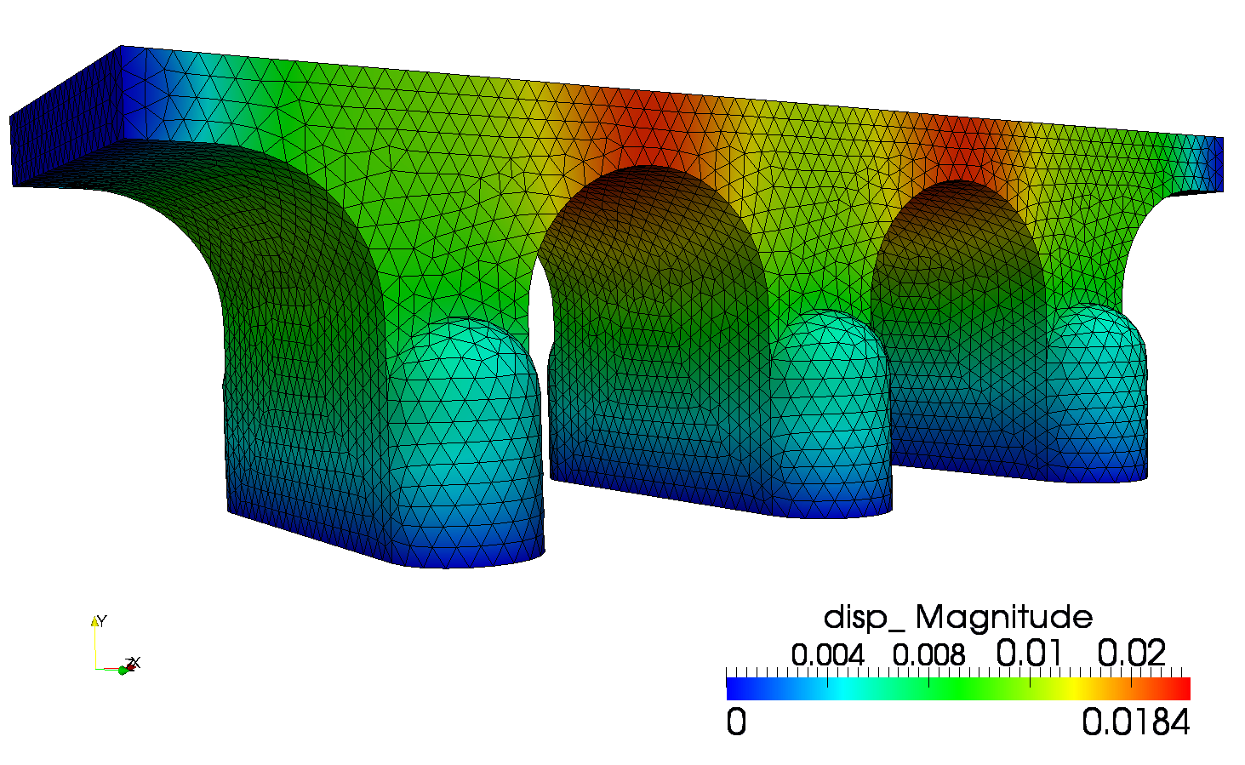
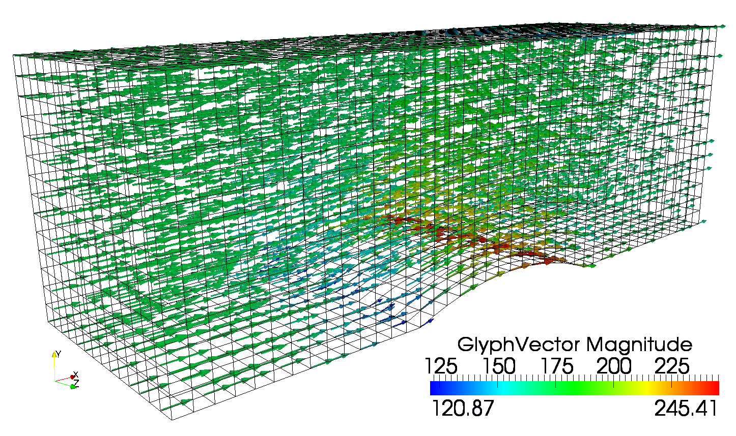
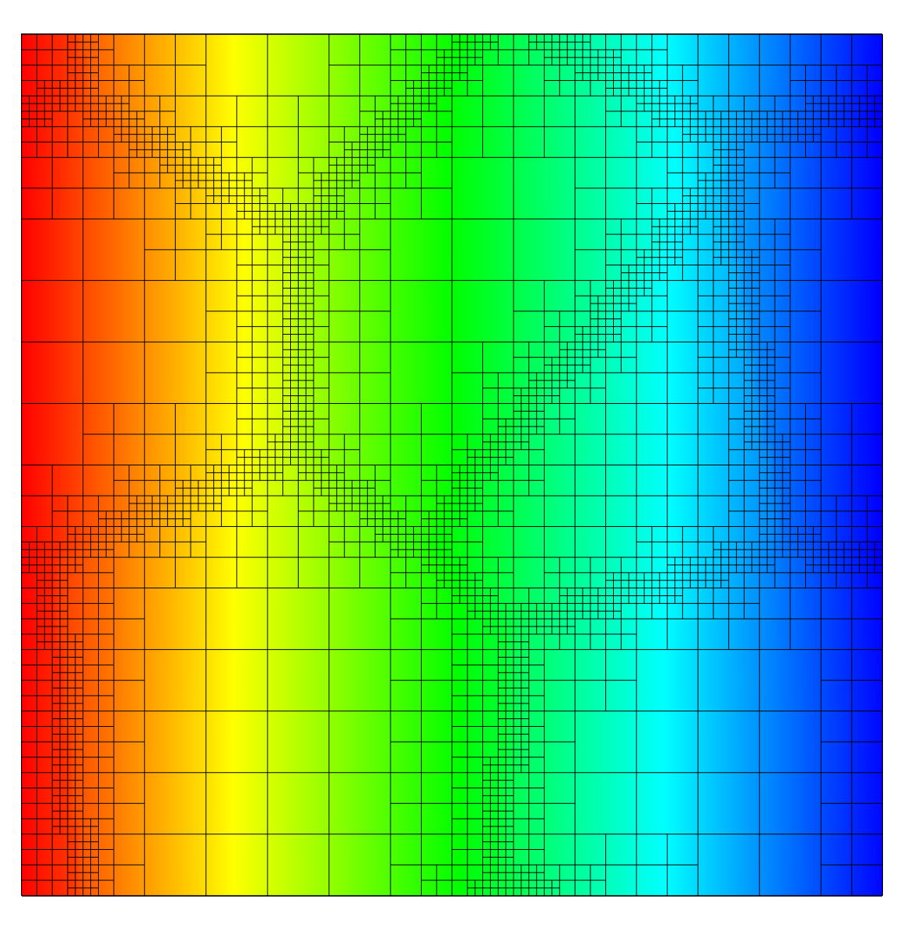

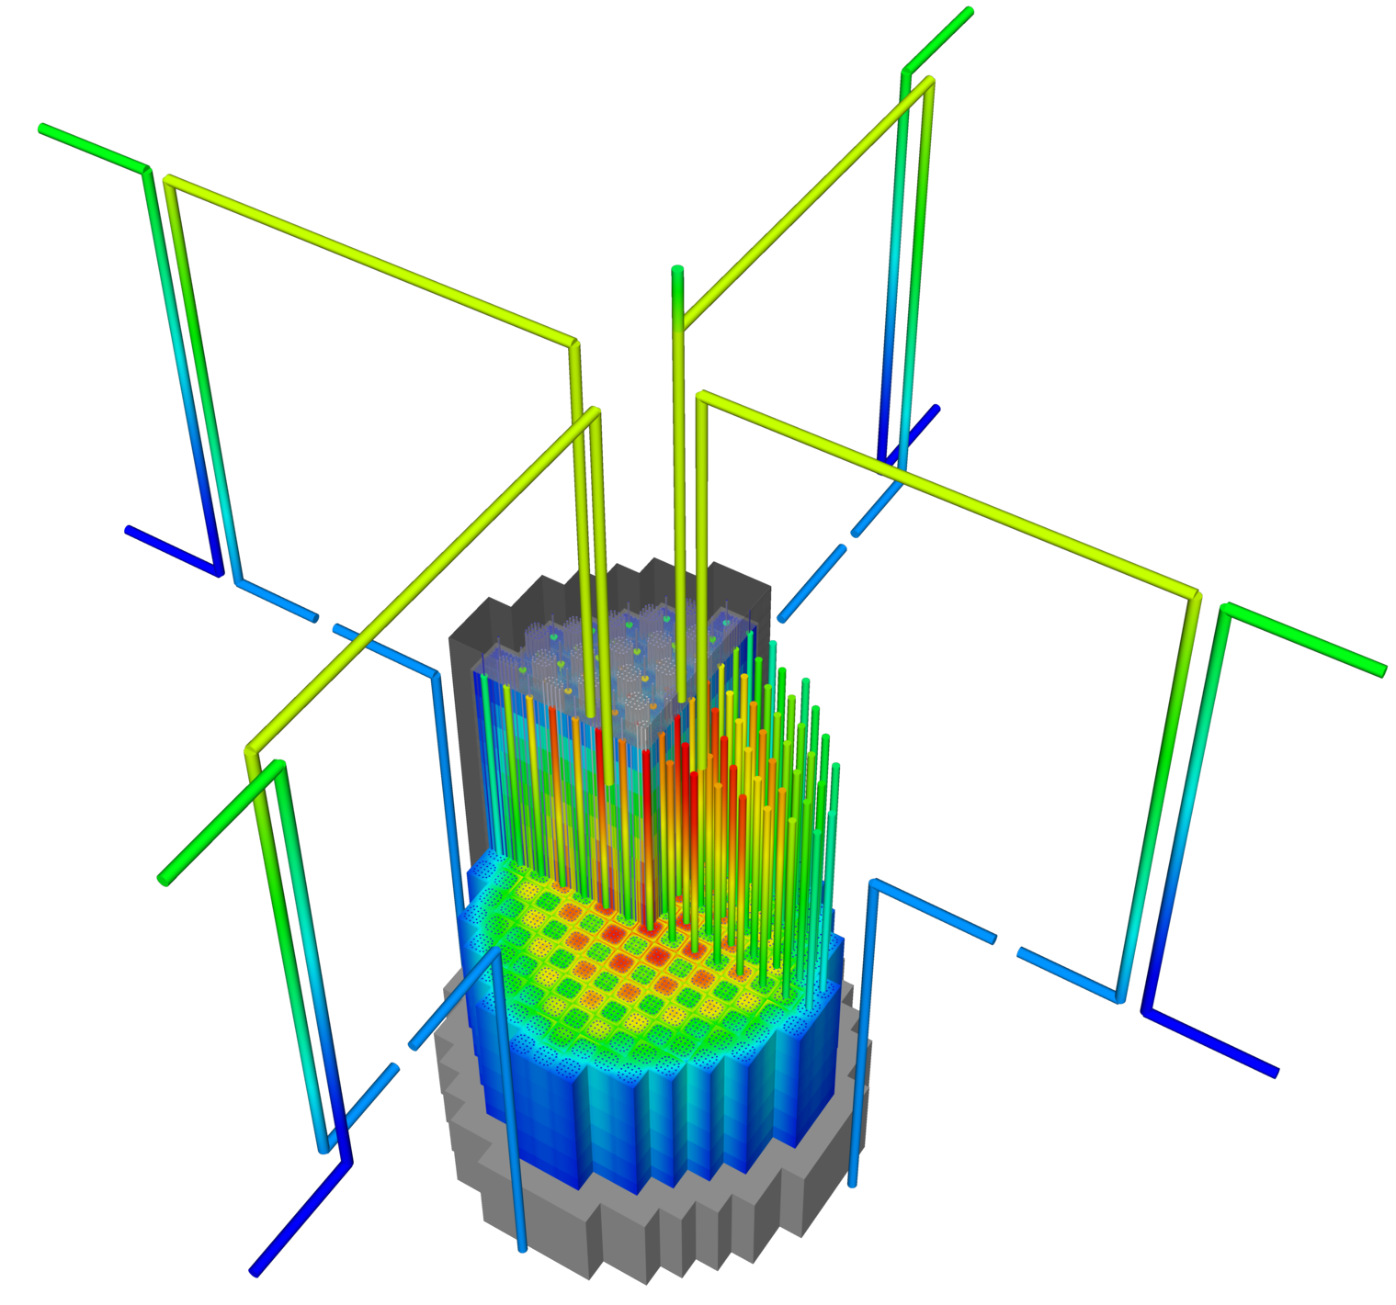

The MOOSE Framework
Open-source, massively parallelizable, finite element framework written in C++, focusing on multiphysics coupling
Started in 2008, open-sourced and received R&D 100 in 2014
NQA-1 compliant
Some numbers:
208+ contributors
46,000+ commits
5000+ unique visitors per month
2000+ citations for MOOSE papers
70M+ tests per week

Slide 5
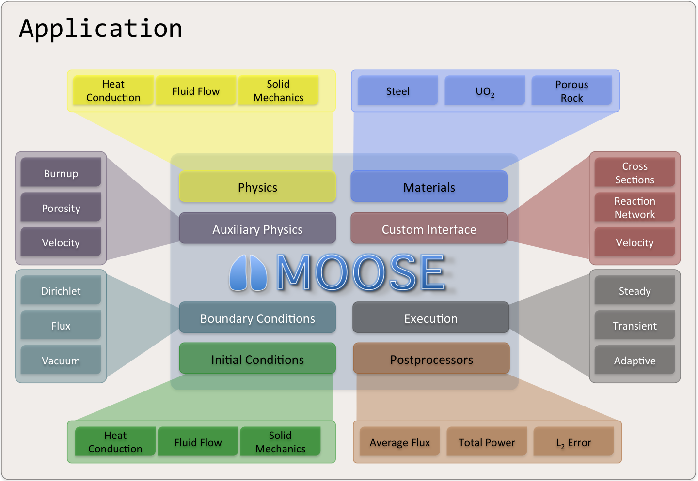
Overview of Capabilities
Object-oriented, pluggable system
Continuous and Discontinuous Galerkin Finite Element Method (FEM), Finite Volume (FV)
Multiphysics, multiscale
Explicit or implicit time integration
Automatic differentiation (AD)
Unstructured mesh
Higher-order geometry
Mesh adaptivity (refinement and coarsening)
Massively parallel (MPI and threads)
User code agnostic of dimension, parallelism, shape functions, etc.
OS: Mac, Linux, or Windows (WSL)

Slide 6
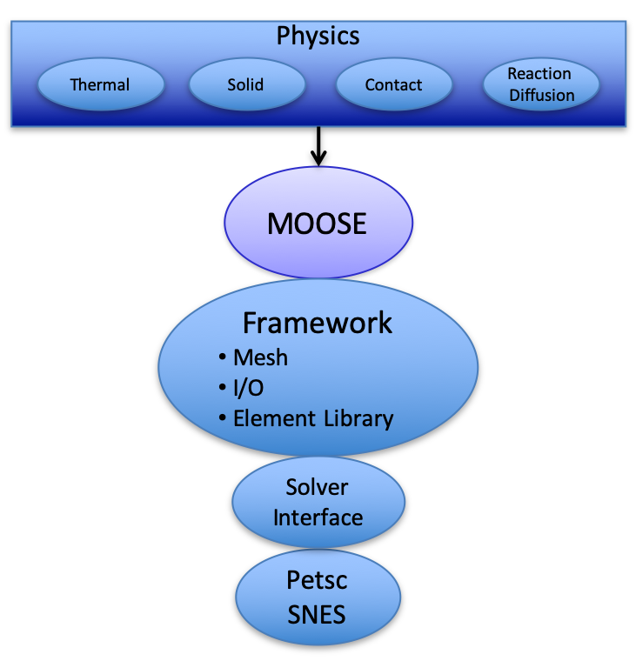
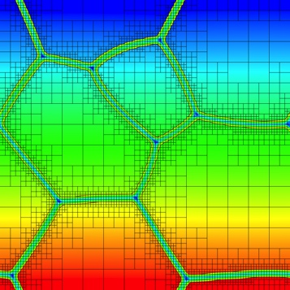
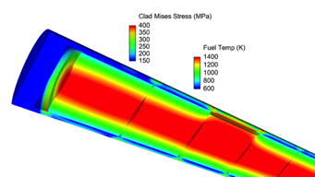
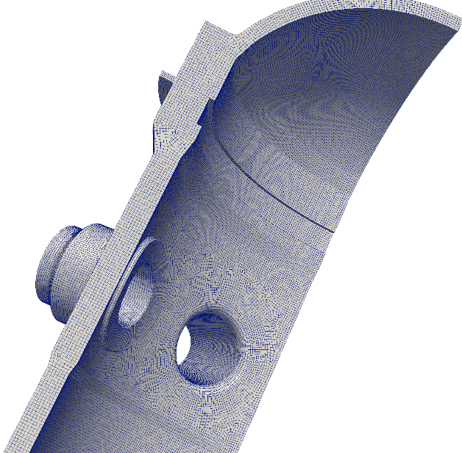




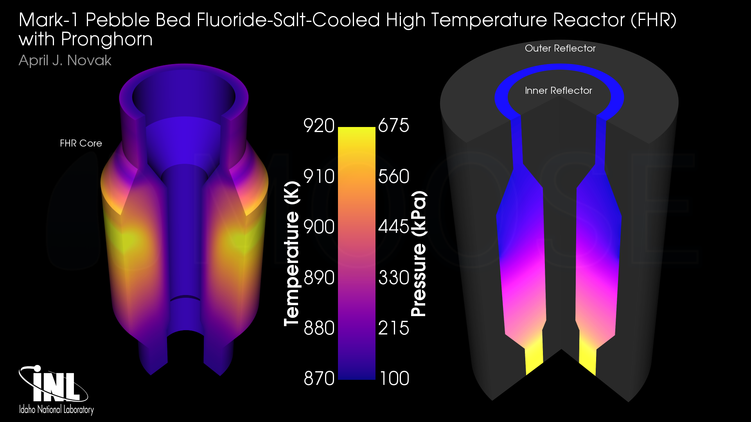
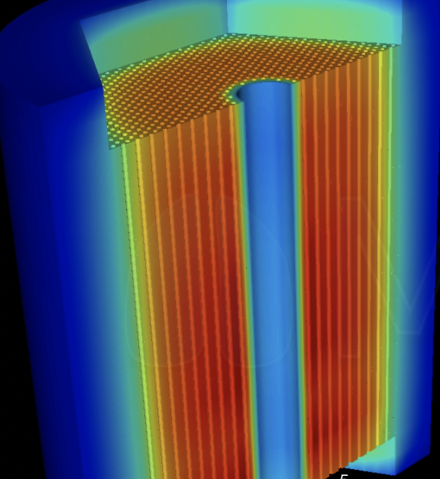
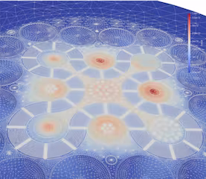
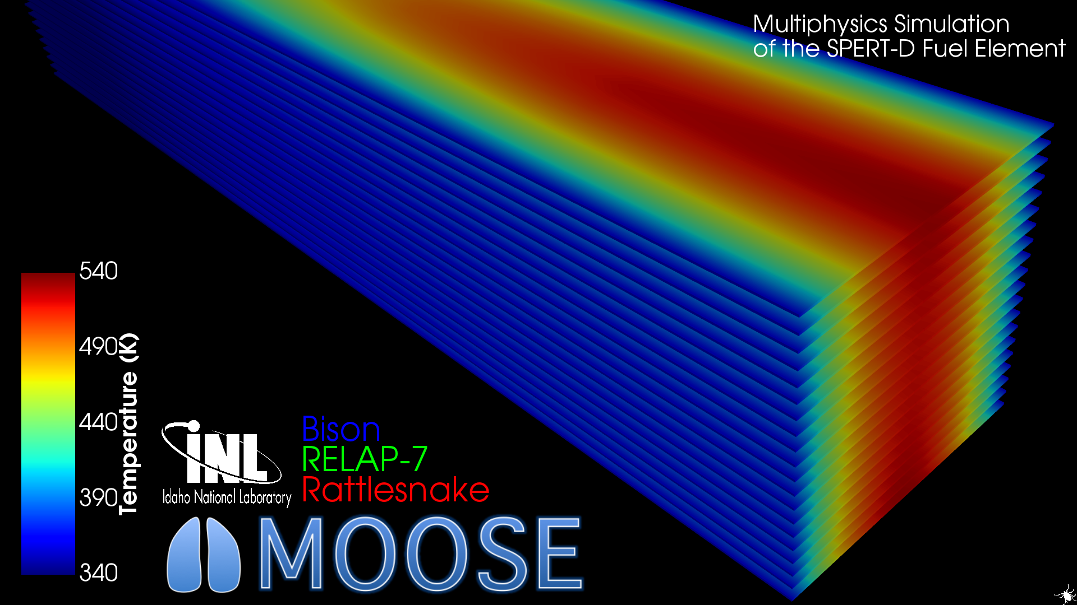




Some INL Nuclear Applications
MOOSE
HPC Framework
Marmot
Mesoscale Materials
Bison
Nuclear Fuel Performance
Grizzly
Structural Mechanics for
Component Aging
GRIFFIN
Reactor Multiphysics
Pronghorn
Porous Medium Flow
Sockeye
Heat pipe Simulation
RELAP-7
Multiscale Multiphysics
Systems Analysis

Slide 7
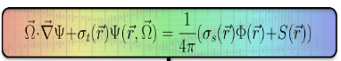

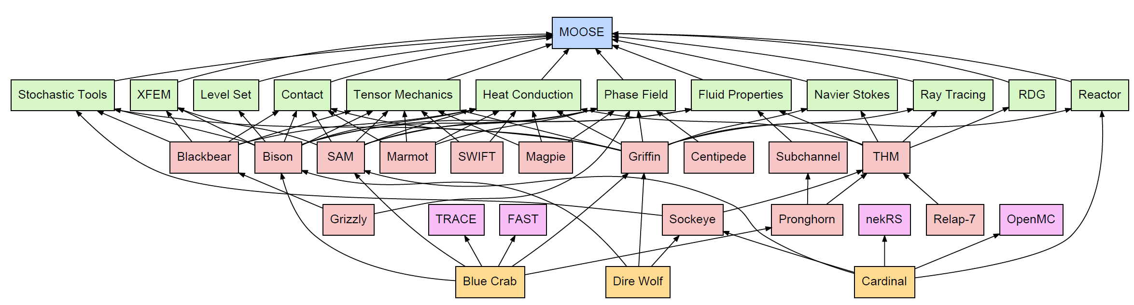
MOOSE Framework Ecosystem
MOOSE Framework
MOOSE Modules
MOOSE-Based Applications
MOOSE-Wrapped Applications
MOOSE-Coupling Applications
7
Notes:
LMFR – liquid metal-cooled fast

Slide 8
Part 1: How to install MOOSE

Slide 9
Installing MOOSE
If on Windows, follow these instructions first: https://mooseframework.inl.gov/getting_started/installation/windows.html
Installation from source (recommended): https://mooseframework.inl.gov/getting_started/installation/conda.html cd ~/projects/moose/modules make –j 10
Installation of binary (can be done additionally or alternatively): https://mooseframework.inl.gov/getting_started/installation/moose_conda_binary.html
Examples for this workshop: cd ~/projects git clone git@github.com:joshuahansel/ans_workshop.git cd ~/projects/moose mkdir ans_workshop cp ../ans_workshop/* ans_workshop

Slide 10
Part 2: How to run a MOOSE input file

Slide 11
Executables
Executables for MOOSE only may be created/obtained via these instructions: https://mooseframework.inl.gov/getting_started/installation/index.html
Executables for existing MOOSE-based applications may be obtained by following their respective directions
Run moose -h to get a list of command-line options
Run serially: moose -i myinput.i
Run with 4 threads: moose -i myinput.i --n-threads=4
Run with 4 MPI processes: mpiexec -n 4 moose -i myinput.i
Exercise: Run heat_conduction.i all three ways, using the "-t" flag to produce a timing table

Slide 12
Viewing Output
Output quantities, output frequency, and format are specified in the input file
Possible formats include:
Exodus [*.e]: recommended for space-dependent variables
CSV [*.csv]: recommended for scalar (0D) post-processed data
XML [*xml]: recommended for vector post-processed data
Others
Exercise: View the Exodus output file from heat_conduction.i in Paraview

Slide 13
Part 3: How to write a MOOSE input file

Slide 14
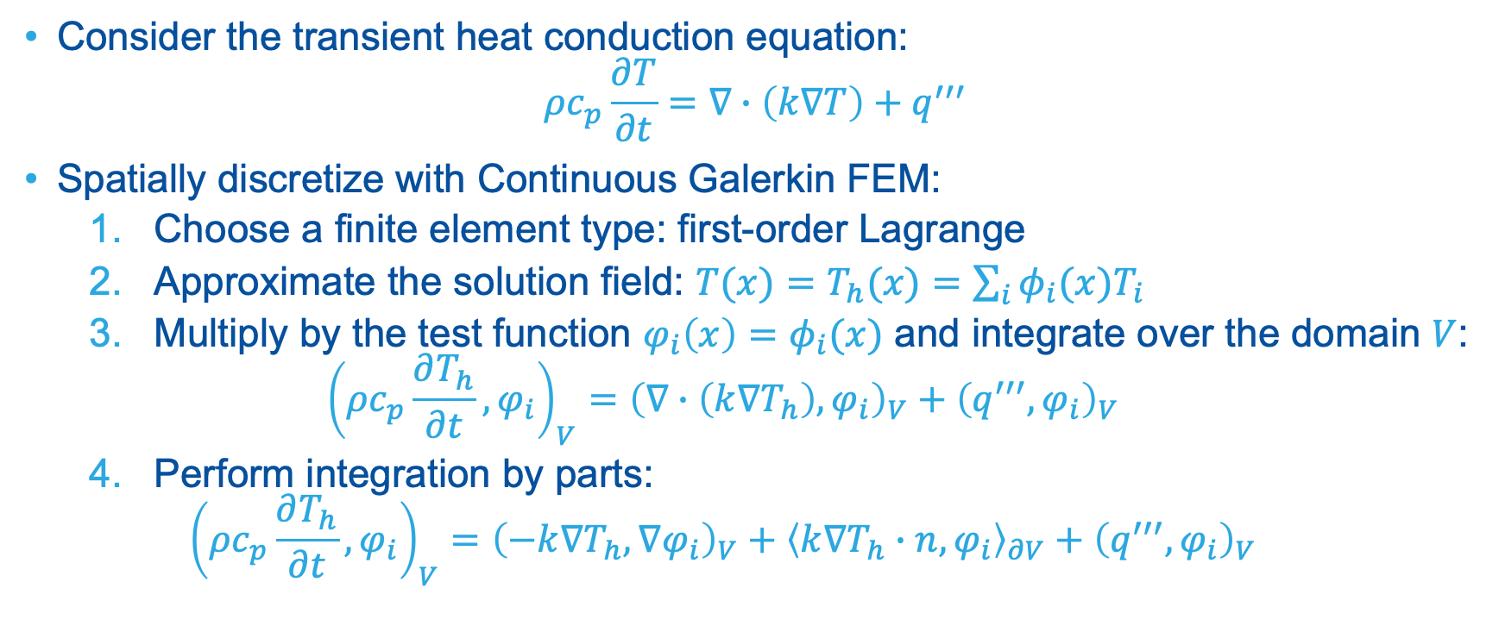
Finite Element Method Example
Consider the transient heat conduction equation: $ρc_{p}\frac{∂T}{∂t}=∇∙\left(k∇T\right)+q^{′′′}$
Spatially discretize with Continuous Galerkin FEM:
Choose a finite element type: first-order Lagrange
Approximate the solution field: $T(x)=T_{h}(x)=\sum_{i}{φ_{i}(x)T_{i}}$
Multiply by the test function $φ_{i}\left(x\right)=φ_{i}(x)$ and integrate over the domain $V$: ${\left(ρc_{p}\frac{∂T_{h}}{∂t},φ_{i}\right)}_{V}={\left(∇∙\left(k∇T_{h}\right),φ_{i}\right)}_{V}+{\left(q^{′′′},φ_{i}\right)}_{V}$
Perform integration by parts: ${\left(ρc_{p}\frac{∂T_{h}}{∂t},φ_{i}\right)}_{V}={\left(−k∇T_{h},∇φ_{i}\right)}_{V}+{\left\langle k∇T_{h}∙n,φ_{i}\right\rangle }_{∂V}+{\left(q^{′′′},φ_{i}\right)}_{V}$

Slide 15
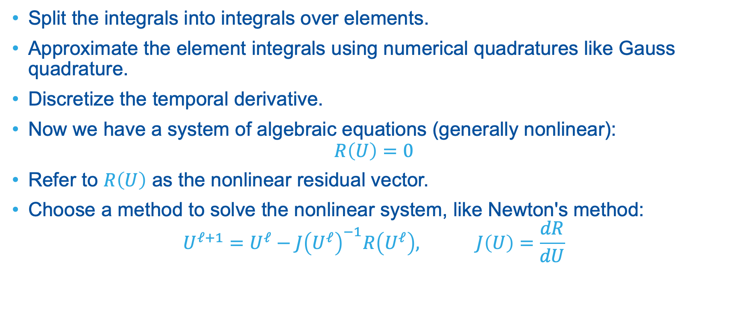
Finite Element Method Example
Split the integrals into integrals over elements.
Approximate the element integrals using numerical quadratures like Gauss quadrature.
Discretize the temporal derivative.
Now we have a system of algebraic equations (generally nonlinear): $R\left(U\right)=0$
Refer to $R\left(U\right)$ as the nonlinear residual vector.
Choose a method to solve the nonlinear system, like Newton's method: $U^{ℓ+1}=U^{ℓ}−{J\left(U^{ℓ}\right)}^{−1}R\left(U^{ℓ}\right), J\left(U\right)=\frac{dR}{dU}$

Slide 16
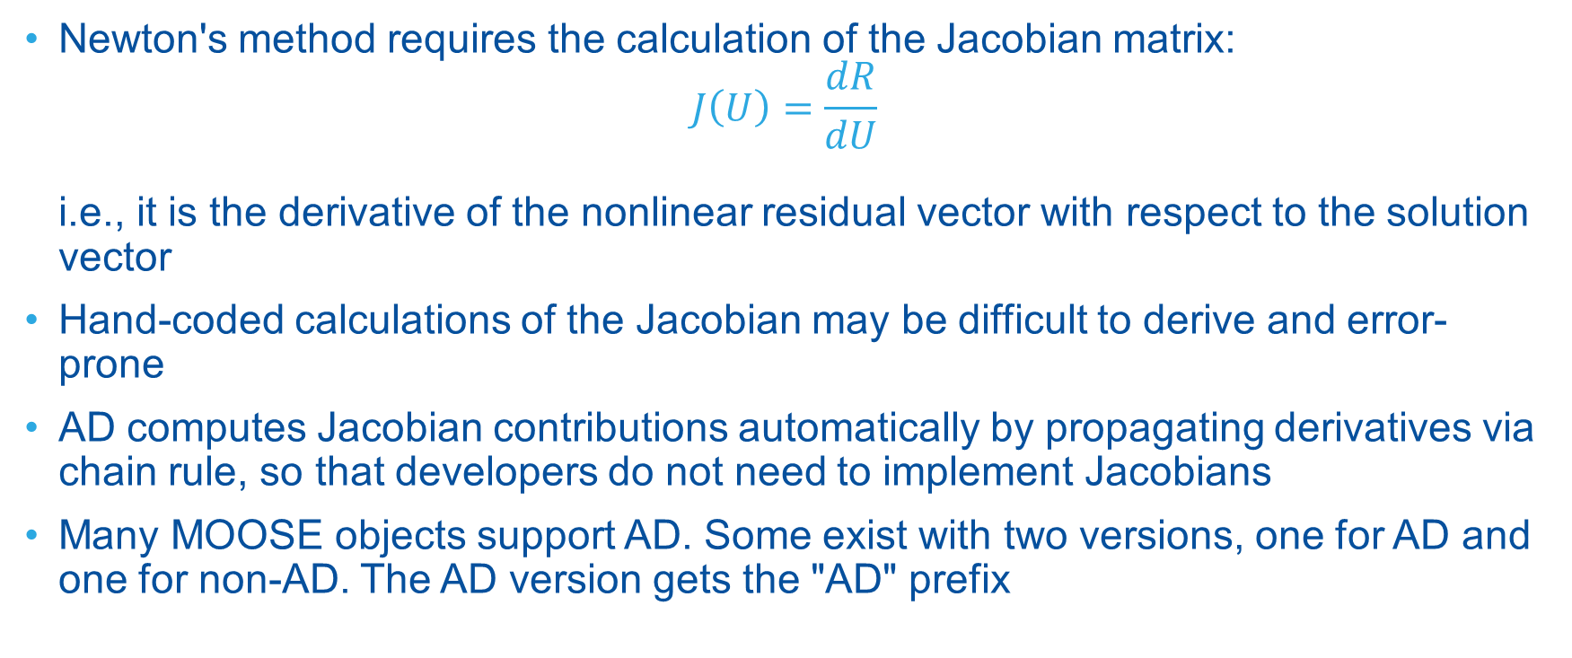
Automatic Differentiation (AD)
Newton's method requires the calculation of the Jacobian matrix: $J\left(U\right)=\frac{dR}{dU}$ i.e., it is the derivative of the nonlinear residual vector with respect to the solution vector
Hand-coded calculations of the Jacobian may be difficult to derive and error-prone
AD computes Jacobian contributions automatically by propagating derivatives via chain rule, so that developers do not need to implement Jacobians
Many MOOSE objects support AD. Some exist with two versions, one for AD and one for non-AD. The AD version gets the "AD" prefix

Slide 17
Input File Structure
Block-based input file structure, with possible nesting: [MyBlock1] # stuff here [] [MyBlock2] [mysubblockA] # stuff here [] [mysubblockB] # stuff here [] []
Top-level block names correspond to certain systems or actions in MOOSE. Examples:
[Mesh] for loading/generating a mesh
[Outputs] for specifying output(s)
Sub-blocks usually correspond to MOOSE objects of that system. Users name these: [Kernels] [mydiffusion] type = Diffusion
Sometimes there are specifically-named sub-blocks in a block (sub-systems). Example: [Executioner] [TimeSteppers]

Slide 18
Input File Structure
Blocks/sub-blocks have input parameters of various types:
Floating-point numbers: param1 = 5.0
Integers: param1 = 5
Strings: param1 = "mystr"
Lists of any of these: param1 = '2.0 45 4e-6'
Comments specified on any line with #: param1 = 5.0 # my comment
They can be on their own line too
[GlobalParams] is a special block that substitutes its parameters anywhere where they apply, i.e., they are "global" parameters. You can locally override.

Slide 19
Input File Features
Values can be defined at the top of the input file and substituted in multiple places: myval = 5 [Block1] [myobj1] type = ClassA param1 = ${myval} [] [myobj2] type = ClassB param2 = ${myval} [] []
You can evaluate math expressions: radius = 5 diameter = ${fparse 2 * radius} area = ${fparse pi * radius^2} For a list of operators: http://warp.povusers.org/FunctionParser/fparser.html#literals
You can convert units: param1 = ${units 1 in -> m} For a list of units: https://mooseframework.inl.gov/source/utils/Units.html

Slide 20
Input File Features
You can use "include" statements in input files: !include otherinput.i This effectively substitutes that file's contents at this location. Parameters cannot be specified multiple times, i.e., there is no parameter-overriding in this way.
You can also supply multiple input files on the command-line: moose -i input1.i input2.i input3.i Input files to the right override those to the left.

Slide 21
VSCode (Optional)
VSCode is an open-source text editor and integrated development environment
We recommend it because of support for MOOSE input files; the extension "MOOSE Language Support" provides:
Syntax highlighting for MOOSE input files
Autocompletion
Class and parameter descriptions
Keyboard shortcut to bring up class/parameters boxes: Ctrl+Space
Additional setup if using pre-built MOOSE binary: conda env config vars set MOOSE_LANGUAGE_SERVER=$HOME/miniforge/envs/my-moose-env/moose/bin/moose
For more information: https://mooseframework.inl.gov/help/development/VSCode.html

Slide 22
Common MOOSE Systems Overview
Mesh: Load/generate/modify a mesh
Variables: Define solution variables
AuxVariables: Define non-solution variables
AuxKernels: Define how to compute AuxVariables
Kernels: Define volumetric physics terms
BCs: Define boundary physics terms
Materials: Define "properties" at quadrature points
Functions: Define functions of x,y,z,t
Postprocessors: Define scalar quantities
VectorPostprocessors: Define vectors
Preconditioning: Define preconditioner matrix
Executioner: Define execution, like steady vs. transient, temporal discretization, and convergence
Outputs: Define output(s)

Slide 23
Mesh System
MOOSE's mesh generator system can be used:
To load an external mesh from a file (different formats possible), such as from an external mesh-generator like CUBIT.
To generate meshes within MOOSE.
To modify meshes.
Mesh generators are chained together to produce the final mesh.
To only generate the mesh without running the simulation, you can pass --mesh-only on the command line.

Slide 24
Mesh Definitions
A node is a vertex of the mesh and has a global index, starting from 0.
An element is the volume between vertices and has an index, starting from 0.
A side is a face of an element and is defined by a local index, starting from 0.
A block is a set of elements, either the full mesh or a subset.
A block has an ID (index, starting from 0) and may have a name too.
A boundary is either a side set or a node set.
A side set is a set of (element, side) pairs.
A node set is a set of nodes.
Each type of set has an ID and may have a name too.
Often side sets and node sets are mirrored with the same name.

Slide 25

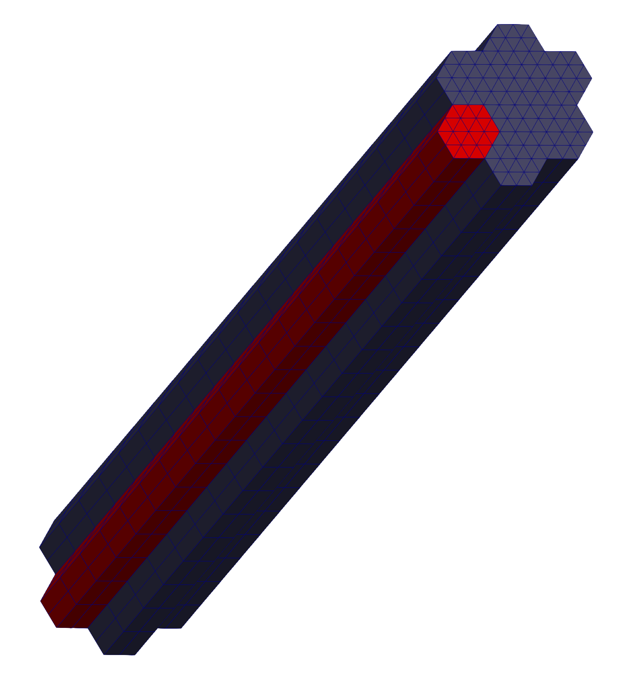
Meshing Exercise
Exercise: Build the mesh shown to the right.
Hex apothem: 1 cm
Length: 1 m
Strategy:
Build 2D unit cells for fuel and reflector
Assemble those into pattern
Extrude
Clean up
Reflector
Fuel

Slide 26
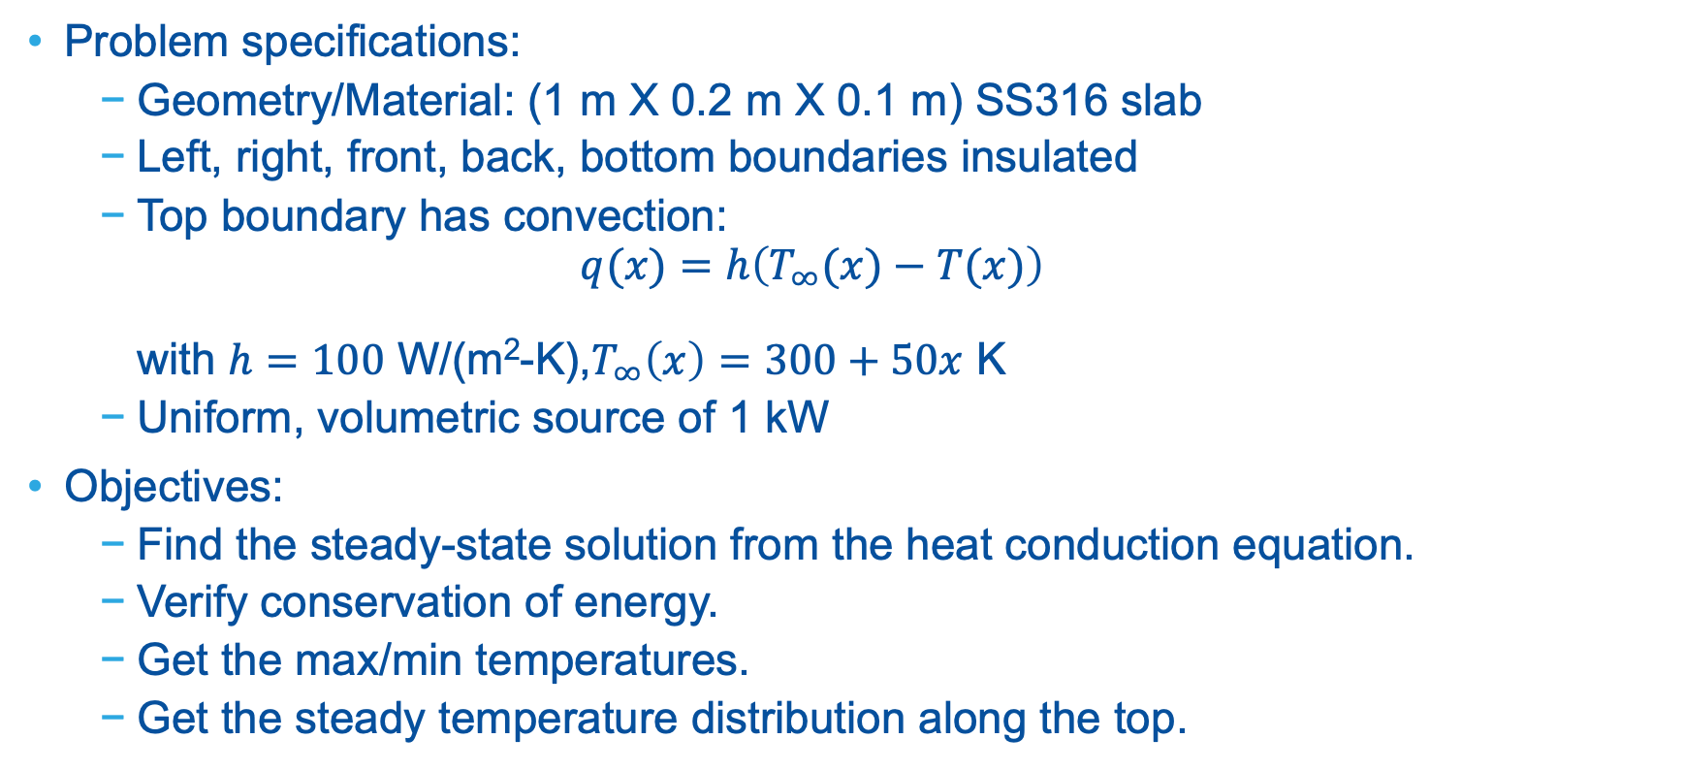
Physics Problem Exercise
Problem specifications:
Geometry/Material: (1 m X 0.2 m X 0.1 m) SS316 slab
Left, right, front, back, bottom boundaries insulated
Top boundary has convection: $q(x)=h\left(T_{∞}(x)−T(x)\right)$ with $h=100$ W/(m²-K),$T_{∞}\left(x\right)=300+50x$ K
Uniform, volumetric source of 1 kW
Objectives:
Find the steady-state solution from the heat conduction equation.
Verify conservation of energy.
Get the max/min temperatures.
Get the steady temperature distribution along the top.

Slide 27
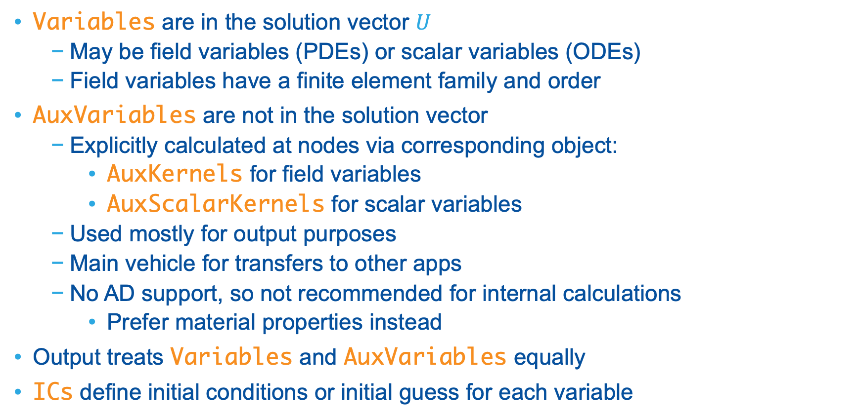
Variables and AuxVariables
Variables are in the solution vector $U$
May be field variables (PDEs) or scalar variables (ODEs)
Field variables have a finite element family and order
AuxVariables are not in the solution vector
Explicitly calculated at nodes via corresponding object:
AuxKernels for field variables
AuxScalarKernels for scalar variables
Used mostly for output purposes
Main vehicle for transfers to other apps
No AD support, so not recommended for internal calculations
Prefer material properties instead
Output treats Variables and AuxVariables equally
ICs define initial conditions or initial guess for each variable

Slide 28
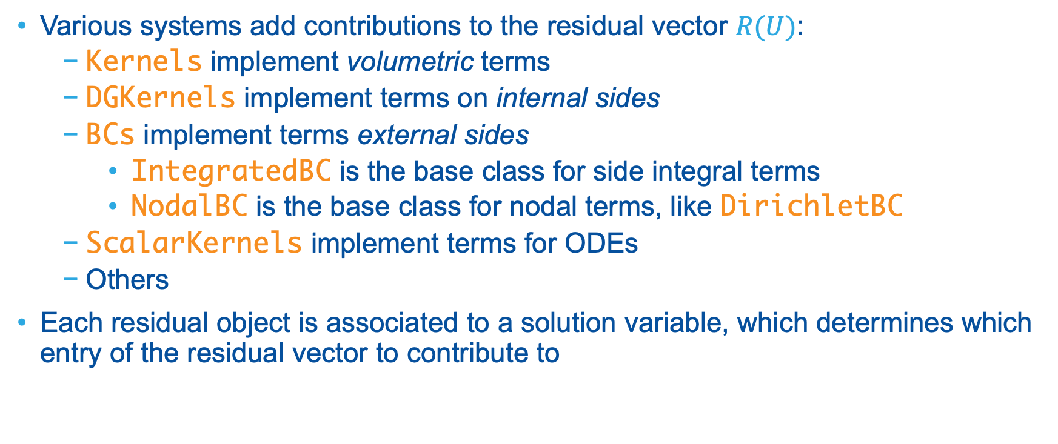
Residual Systems
Various systems add contributions to the residual vector $R(U)$:
Kernels implement volumetric terms
DGKernels implement terms on internal sides
BCs implement terms external sides
IntegratedBC is the base class for side integral terms
NodalBC is the base class for nodal terms, like DirichletBC
ScalarKernels implement terms for ODEs
Others
Each residual object is associated to a solution variable, which determines which entry of the residual vector to contribute to

Slide 29
Materials System
Each Material creates one or more material properties.
Material properties are quantities that are computed at each quadrature point.
Various systems may then use these material properties.
A material property may be AD or non-AD, and consuming objects expect one or the other.
MaterialADConverter can convert between the two types (note non-AD to AD must be used with care).
Similar system: FunctorMaterials
Creates one or more functor material properties.
Computed "on-the-fly"
Unlike regular material properties, are functors.

Slide 30
Executioner System
The executioner determines which kind of problem to solve, like:
Steady
Transient
Eigenvalue
Others
This system has subsystems like:
TimeIntegrator: For Transient: the time integration scheme to use
TimeStepper: For Transient: how to compute time step size
Quadrature: Rule to use for numerical integrations on elements/sides
Also specifies solve parameters (next slide)

Slide 31
Solve Parameters
Solve type specified in Executioner block:
NEWTON
PJFNK
LINEAR
Solve parameters like convergence tolerances
Steady-state detection for Transient
PETSc command-line flags can be supplied
A Preconditioning block can be specified to customize the preconditioning

Slide 32
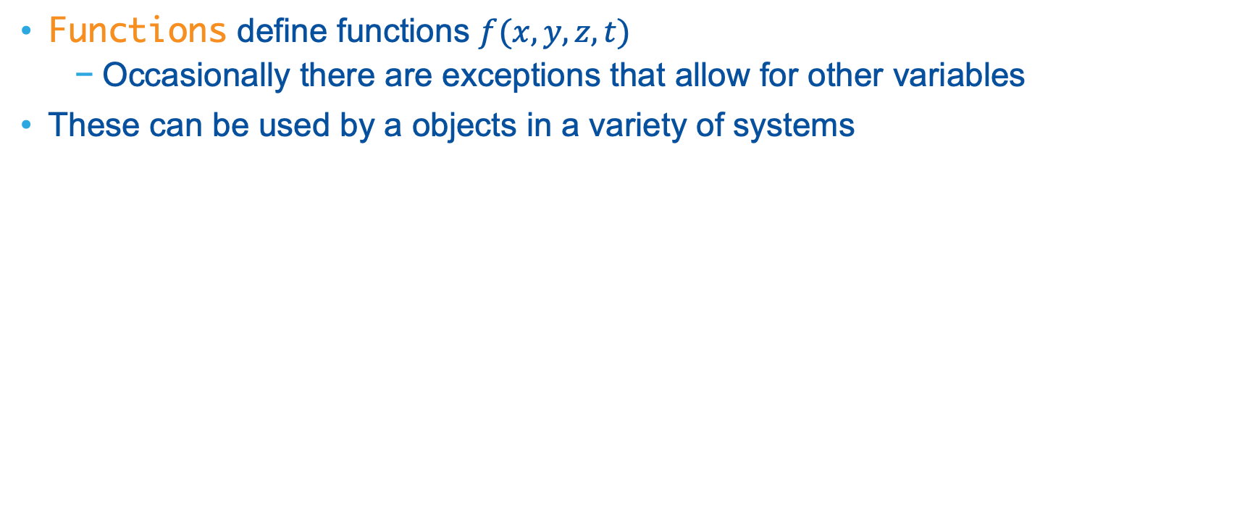
Functions System
Functions define functions $f(x,y,z,t)$
Occasionally there are exceptions that allow for other variables
These can be used by a objects in a variety of systems

Slide 33
Postprocessors and VectorPostprocessors Systems
Postprocessors compute a single, scalar value
Typically used for post-processing
Can be output to CSV files
Examples:
Sample a quantity at a particular point
Find the max/min/integral/average of a quantity over a block/boundary
VectorPostprocessors compute one or multiple vectors of values
Can be output to CSV and XML files
Examples:
Sample a quantity along a boundary at each node

Slide 34
Outputs System
Outputs specify output, whether to the console or to a file.
Common classes:
Console
CSV
Exodus
XMLOutput

Slide 35
UserObjects System
Flexible system that allows users to define their own operations to perform
Other objects can call user-defined interfaces on these UserObjects
Types:
GeneralUserObject: does not operate on a mesh entity
ElementUserObject: operates on each element
SideUserObject: operates on each side
Postprocessors and VectorPostprocessors are just UserObjects that are responsible for producing certain values

Slide 36
Part 4: How to write MOOSE code

Slide 37
Prerequisites
Knowledge of C++
Object-Oriented Programming (OOP)
Classes, inheritance
Templates (advanced; may not necessarily need)
Knowledge of git
Need to fork MOOSE and/or the "stork" to initiate your repo(s).
Need to add, commit, push, and fetch/pull your changes to repos.
For new applications, MOOSE will be a submodule.
Collaborative workflows also require knowledge of rebase and merge.

Slide 38
Getting Started
Decide if you want to make a new application or just work with MOOSE.
Reasons to make your own application:
Privacy: protect intellectual property or sensitive material
Freedom of software development; don't need to follow NQA-1 for example.
Reasons to contribute to MOOSE:
Others can take advantage of your work (and cite it).
May be more convenient than making your own application.
If making your own application:
You must run the "stork" script to initialize your new repo: https://mooseframework.inl.gov/getting_started/new_users.html
If not making your own application, you should simply fork MOOSE: https://mooseframework.inl.gov/framework/contributing.html

Slide 39
Code Example
Consider the Diffusion kernel. The base class is Kernel.
Header file located at framework/include/kernels/Diffusion.h
Source file located at framework/src/kernels/Diffusion.C
We must override the method Real computeQpResidual() and optionally can override Real computeQpJacobian().
These correspond to the residual and Jacobian matrix evaluations at a quadrature point.
Exercise: View the above files and discuss each line.

Slide 40
Source Code Examples
Kernel: Diffusion
BC: NeumannBC
Postprocessor: ElementIntegralPostprocessor
AuxKernel: FunctionAux
IC: RandomIC
Material: GenericFunctionMaterial
FunctorMaterial: GenericFunctorMaterial
Function: LinearCombinationFunction
VectorPostprocessor: SideValueSampler

Slide 41
Part 5: How to learn more MOOSE

Slide 42
MOOSE Website
Located at https://mooseframework.inl.gov/index.html
Highlights:
Installation instructions: https://mooseframework.inl.gov/getting_started/installation/index.html
Examples and tutorials: https://mooseframework.inl.gov/getting_started/examples_and_tutorials/index.html
Upcoming trainings and recordings of past trainings: https://mooseframework.inl.gov/training/index.html
Help forum: https://github.com/idaholab/moose/discussions
Documentation: https://mooseframework.inl.gov/syntax/index.html

Slide 43
Additional Resources
Nuclear Computational Resource Center (NCRC): https://inl.gov/ncrc/
Distributes a variety of codes from INL (mostly MOOSE-based)
More info: https://mooseframework.inl.gov/help/inl/applications.html
The Virtual Test Bed (VTB): https://mooseframework.inl.gov/virtual_test_bed/
Provides a variety of documented examples of various reactors modeled using MOOSE-based applications

